Slide 1
History of Frontend Frameworks

Slide 2
Merriam-Webster definition for history:
a chronological record of significant events (such as those affecting a nation or institution) often including an explanation of their causes

Slide 3


Winners
Losers

Slide 4


Winners
Losers

Slide 5

Winners
Losers
Browser
Compatibility?

Slide 6
Winners
Losers
?

Slide 7
We are developers first. Framework developers second.

Slide 8

1980 - Tim Berners-Lee works at CERN and develops ENQUIRE, the HTML predecessor
1990 - he specified HTML and wrote browser and server software
1991- HTML becomes publicly available

Slide 9
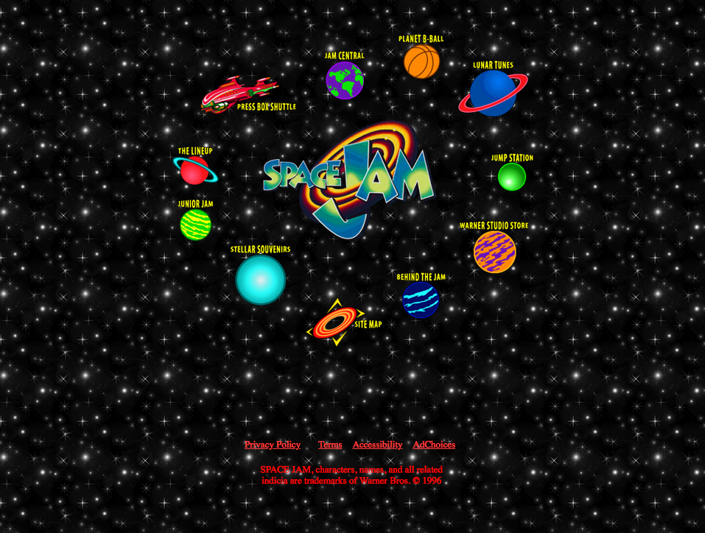
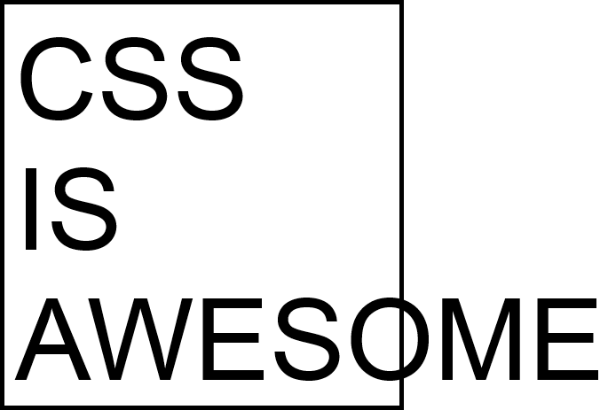
1994 - Håkon Wium Lie proposes CSS
1996 - W3C CSS Recommendation (CSS1) released.
1996 - Space Jam Website is released

Slide 10
1995 (sometime before may) - Brendan Eich gets recruited by Netscape Communications to embed a programming language into Netscape Navigator
1995 (may) - Brendan Eich is tasked to create a prototype for a browser scripting language
10 days later – Javascript was born

Slide 11
With the introduction of JS, developers could start adding behaviors to our website.
Now we can do cool things like ….

Slide 12
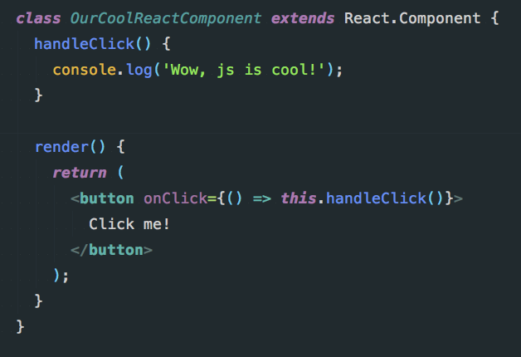
A click event in React

Slide 13
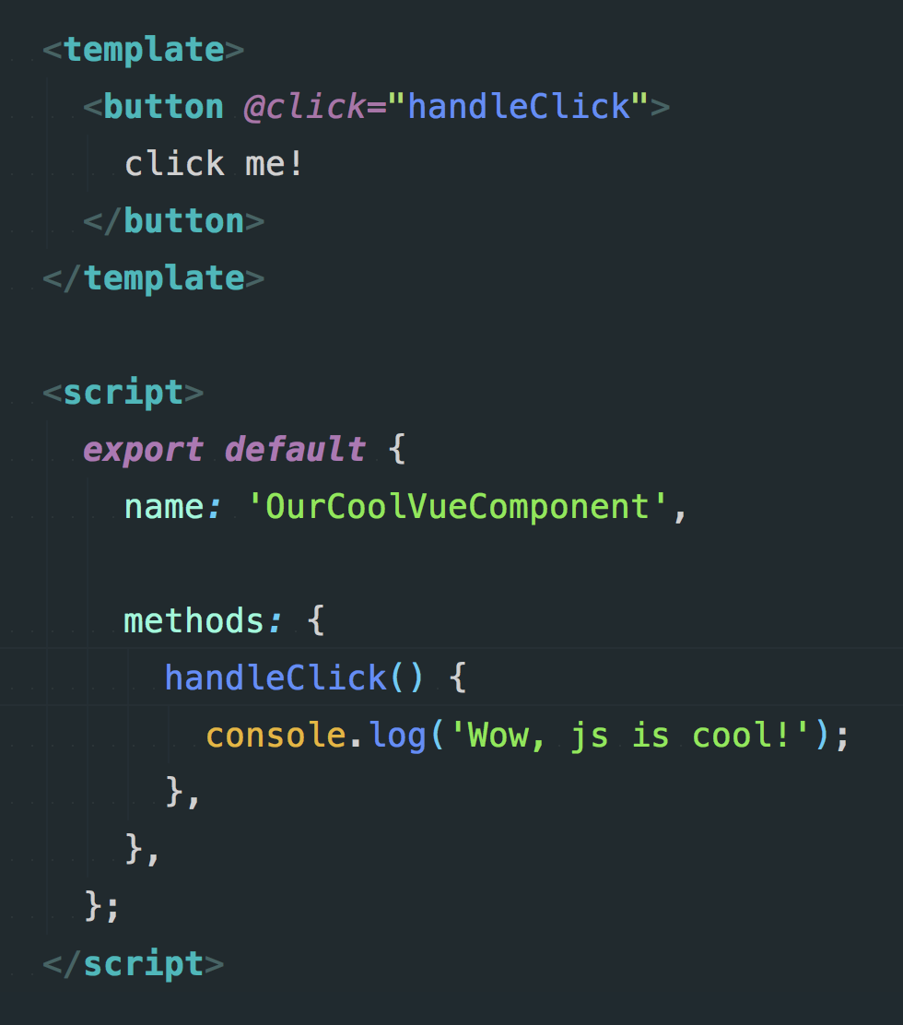
A click event in Vue

Slide 14
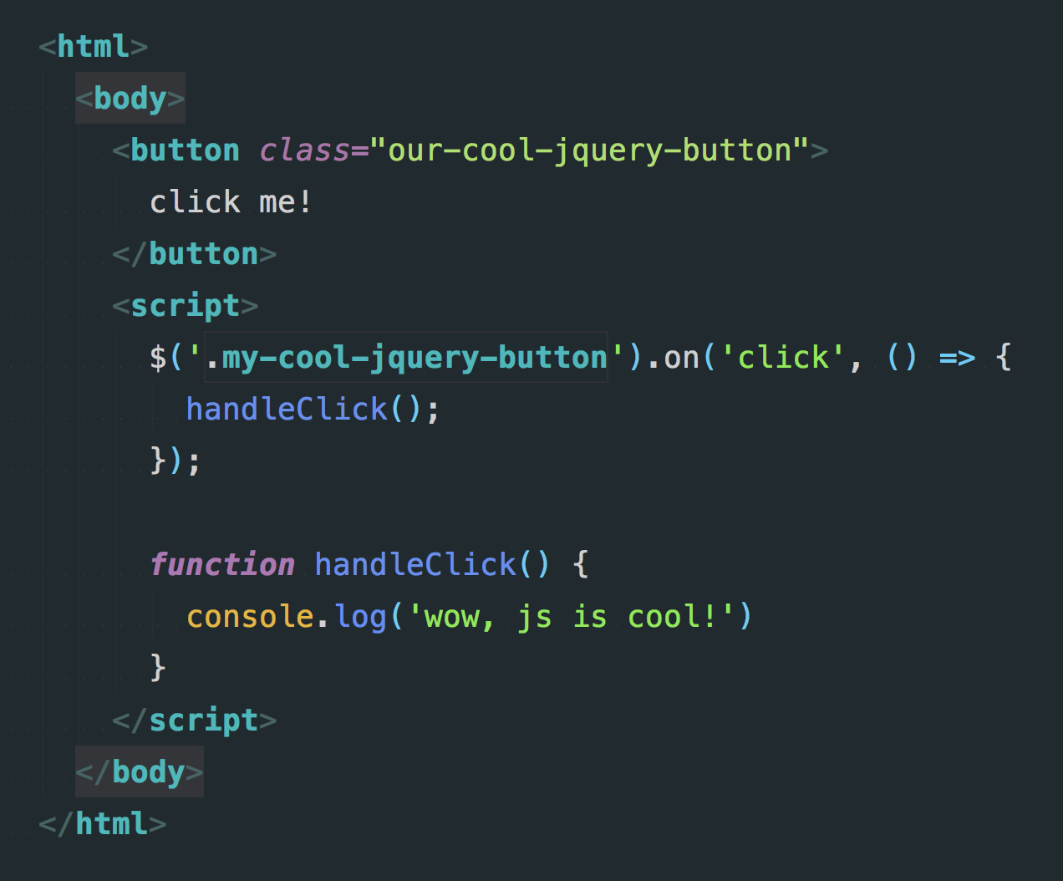
A click event in jQuery

Slide 15
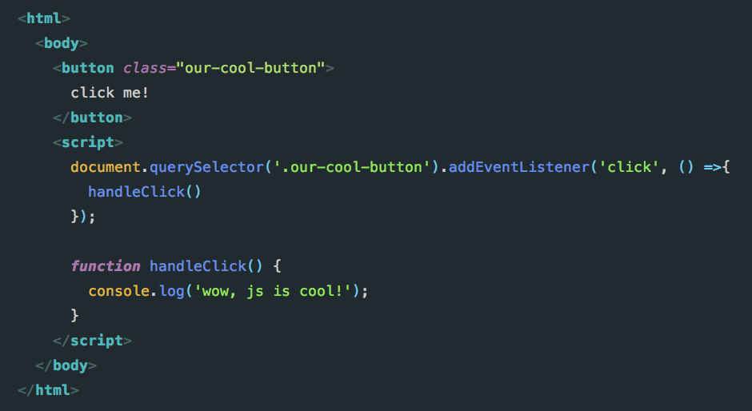
A click event in vanilla JS

Slide 16
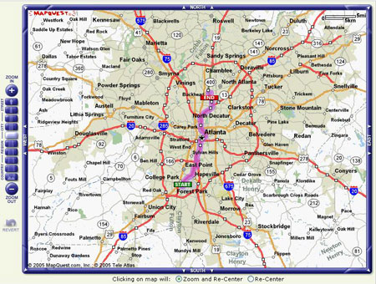
MAPQUEST!

Slide 17

XMLHttpRequest object
In 1998, the Microsoft Outlook web access team created the core competencies that surround the XMLHttpRequest object

Slide 18
XMLHttpRequest object
By 2004 and 2005, google released their gmail and google maps clients using this technology.
By April of 2006, the w3c released the first specification for the XMLHttpRequest object.

Slide 19
jQuery was introduced and initially released August 26 2006.
Solved major browser compatibility issues
Lowered the barrier to entry for web development
It made writing javascript fun

Slide 20
Design Revolution
There was a flurry of innovation in the design space during this time. It was this perfect storm of technology accessibility and creativity.
Designers and Product owners/managers were evolving as fast as the technology was moving.
UI’s were getting more complex than they ever had been before.

Slide 21
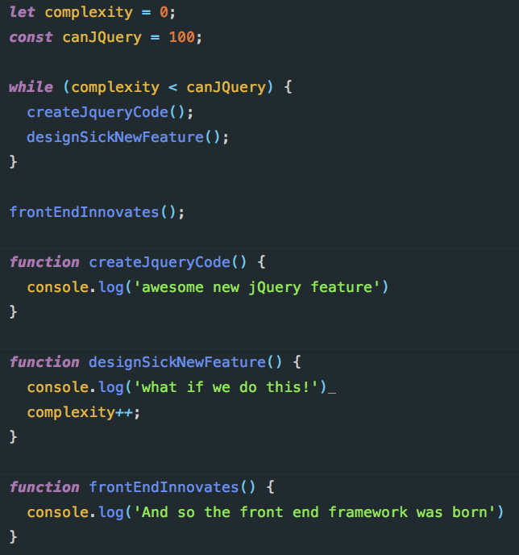



How the Design Revolution killed jQuery … pictogram?
Cool feature
We can do that?!
new feature idea(s)
complexity++
Let’s do more!

Slide 22
!
Why did we evolve past jQuery?
Our modern front end frameworks are born out of the frustrations that jQuery code led to
As a library, jQuery lacks a structure. It lends itself to code that grew unmaintainable when trying to build large applications
We had problems…

Slide 23
Meanwhile…
Server side technologies had been innovating and rolling out new technologies as well. Those technologies set a precedent for the front end
2002 – Spring MVC
2004 – Ruby on Rails
2005 – Django
A common coding pattern, MVC, coupled with REST conventions emerged as a de facto standard of the time for server side web development.

Slide 24

Giant Shoulders – a quick aside
everyone before us
us
We’ve innovated for sure.
Most things today aren’t ostensibly new though
We stand on the shoulders of giants.
The same patterns are used on both server and client
Keep adding to your toolbelt. Learning all aspects of programming, even those outside our craft stands to be beneficial

Slide 25
No more page refreshes!
We wanted, what was historically handled by server side routing and rendering, to have the same capabilities with no page refreshes.
We wanted the Single Page Application.
We needed the Front End Framework

Slide 26


The First of many
Some of the very first JS frameworks to be released are:
Backbone.js – Initial Release October 13, 2010
AngularJS – Initial Release October 20, 2010

Slide 27

What did we gain from front end frameworks?
Client side routing, thus enabling the SPA
Better encapsulation of component logic
Abstraction of some of the explicit DOM interactions
Code maintainability and developer ergonomics
Quicker app prototyping
(AngularJS) 2 way data binding – now a standard feature for most front end frameworks
ng-model

Slide 28
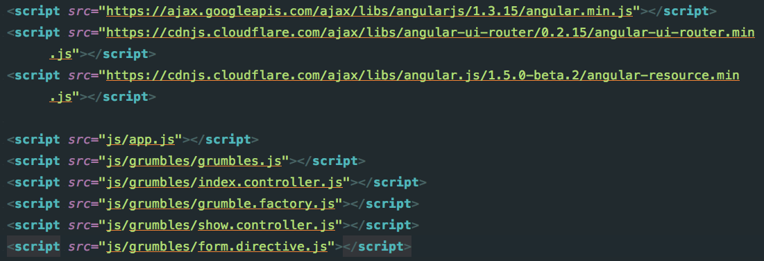
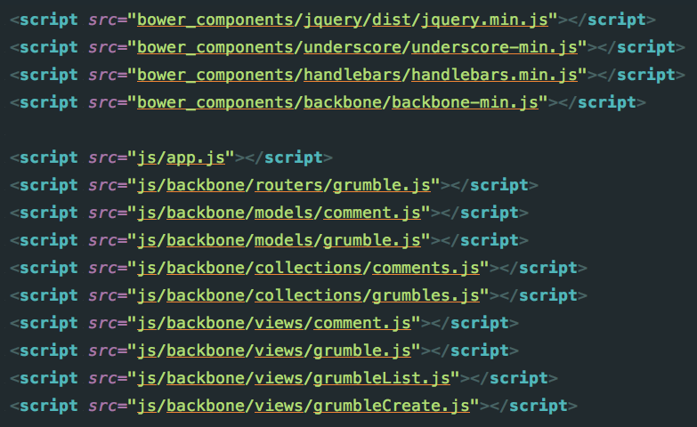
One of our first problems
Dependency management – vendor or otherwise was awful

Slide 29
Node.js
nodeJS is a run-time environment that executes Javascript code outside of a browser #wikipedia
Was written initially by Ryan Dahl in 2009
These days we use a lot of server side node to build client side code – soooo meta
It’s javascript … on a server.
2010 - npm, the package manager for node, was introduced.
There are some others dependency managers worth mentioning like bower and yarn that solved similar problems.

Slide 30



Node.js
The Node.js community despite being “server” JS evolved in tandem with the front end.
Between css precompilers and frameworks like react and vue, there was a real need for automation in the realm of building the application

Slide 31
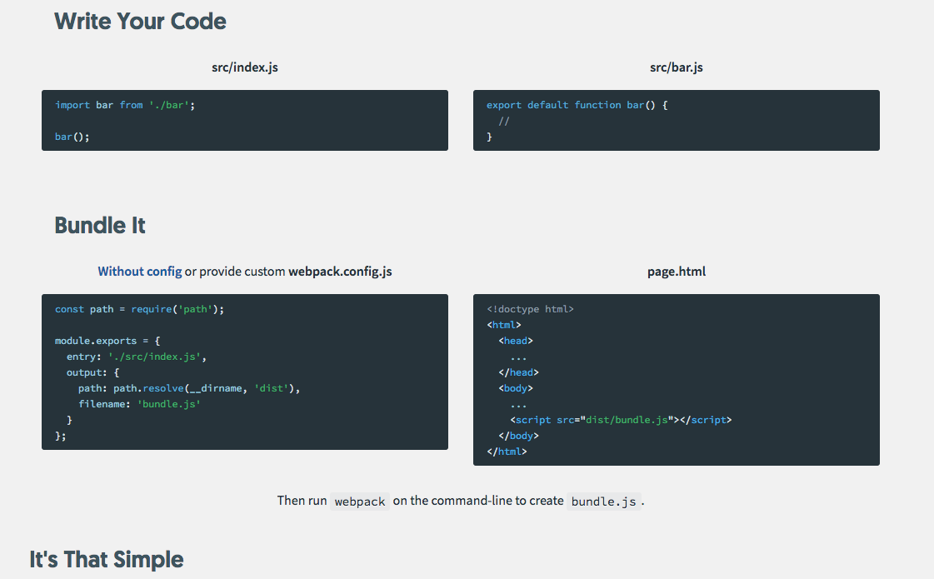
Part of webpack’s landing page:

Slide 32
Build Tools
Build tools like webpack, grunt, gulp allow us to bundle and compile files for usage.
Simple at its core, inputs and outputs.
With growing complexity of ui’s , we needed tooling to help package the code effectively

Slide 33
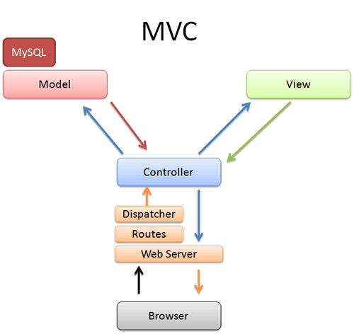
Complex UI problems
The early front end frameworks mirrored MVC type patterns of server side technology.

Slide 34
MV*
MVC can’t hack it in the front end world
The view and model in the front end are largely unchanged.
Our various api calls, instead of DB queries
It’s this relationship between the view and the controller that grew in complexity

Slide 35

The problem with the *
Whether it’s * presenter, the vm, the view model, controller, ctrl, view controller. It had many names … but they all didn’t solve enough…
State management

Slide 36
State management today
No one has opinions about this …
Ok so maybe there’s a lot of opinions about this.
We can all agree that state management today is a lot different then it was even 3-4 years ago.
And amongst all those opinions, they all at their core do the same things while doing them slightly differently
More important might be, what general problems do all state management solutions solve?

Slide 37
State management
Provides us a global namespace for ui state management that isn’t the window
Provides interfaces to mutate and retrieve state
Allows us to define state relationships at various levels(component or module)
Allows us to couple/decouple components as we see fit

Slide 38
I’ve seen good jQuery code
Any technology can be misused.
As developers , our job description leads us to acquiring many tools at our disposal.
By acquiring more tools, we can start to make better judgements surrounding code architecture and implement code more effectively

Slide 39
Don’t focus on syntax
Focus on patterns
and structure
The syntax will come.

Slide 40
We are developers first. Framework developers second.

